Slide 2




35
Years of Innovation
58 Patents Granted
WE ARE
ATX NETWORKS
7M Products Deployed
Making the Connection with market-leading access networking and media distribution solutions
250 Customers in 75 Countries
2,500 Terabytes of Media Every Second

Slide 3

A Closer Look
Vision
Shape the future of Media Delivery through continuous innovation
Mission
Accelerate digital transformation through the development of best-in-class Media Access Solutions
What We Do
Connect Smart Devices to Intelligent Networks
3 | ATX Confidential & Proprietary

Slide 4











Success Through Leadership
Jeff Liening
Global Sales Leader
Kim Lee
Executive Vice President, Marketing
Christina Kotsios
Chief Financial Officer
Derek Panchyshyn
Executive Vice President, Operations
John Higgins
Chief People Officer
Charlie Vogt
President & CEO
“As a leading innovator of access networking technology, ATX is extending the boundaries of digital transformation.”
Keith Landau
Chief Product Officer
Jay Lee
Chief Technology & Strategy Officer, Broadband Access
Mani Ramachandran
Chief Technology & Strategy Officer, Optical Access
Andrew Isherwood
Chief Technology & Strategy Officer, Media Distribution
Jose Rivera
GM, Chief Technology & Strategy Officer, Media Broadcast

Slide 5
Global Operations
Customers rely on our solutions to support mission-critical operations around the world
Asia
Europe
China
Taiwan
Thailand
Germany
Macedonia
Locations
Dallas, TX, USA
San Diego, CA, USA
San Jose, CA, USA
Seattle, WA, USA
Toronto, ON Canada
Frankfurt, Germany
Taipei, Taiwan
ATX has worldwide sales resources supporting all regions
North & Central America
Canada United States Mexico
South America
Pacific
Argentina
Australia

Slide 6







Company Milestones
2014
secure bulk media delivery technology
2012
digital video portfolio
2001
RF signaling
2016
2008
Introduced video processing product family
Satellite and broadcast radio solutions
optical transport solutions
1998
Introduced first RF management platform
2009
Next-Gen RF management platform. Launched secure cable gateway platform
1985
ATX founded
35 Years of Innovation
2006
Introduced RF & optical transmission platform
2000
Introduced Next-Gen RF management solution

Slide 7




Markets Served
CABLE
Enabling MSOs to enhance and expand their access networks to deliver gigabit-or-better bandwidth, as well as generate new revenue through the secure delivery of video to MDUs, hotels and other hospitality businesses
SATELLITE
Offering satellite operators the agility and flexibility to securely and cost-effectively deliver media to properties of any size and to any number of displays
TELCOM/WIRELESS
Provide fixed and wireless telecommunications service providers with the versatility to deliver video services to a broad range of commercial businesses, including MDUs, hotels and other hospitality properties, with coaxial-only wiring
BROADCAST
Enabling audio broadcasters to thrive in today’s content-everywhere media environment—giving them the ability to manage, schedule, and play out content through its entire lifecycle
ATX delivers advanced technologies across diverse and growing markets to enable the delivery of video, audio and data content – better, faster and more economically.

Slide 8
























Global Relationships
OUR CUSTOMER-FIRST APPROACH GUIDES EVERYTHING WE DO
CABLE
SATELLITE
BROADCAST
TELECOM

Slide 9





Mass-Market Gigabit Broadband is Here
Explosion of Video Content
Smart Buildings/Cities
Internet of Things (IoT)
Deeply Immersive Applications
5G Backhaul

Slide 10
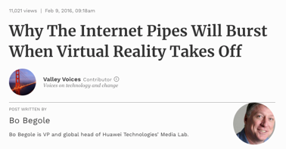
Broadband’s Hyper-Growth
Internet of Things (IoT)
Manufacturing IoT market grew 84% in 2017 ⁽¹⁾
200 million cars connected in 2015 and fully packed with sensor technologies
By 2020, connected vehicles will produce 350MB of data per second
By 2020, the installed base of the IoT devices is forecast to grow to almost 31B worldwide. By 2025 the installed base of IoT devices will be over 75.4B devices ⁽²⁾
IoT connected devices / installed base worldwide from 2015 to 2025 ⁽²⁾ (Billions)
Video on Demand (VOD)
4X increases in bandwidth with every introduction of new resolutions (HD, UHD, 8K)
The number of scripted television shows is increasing every year, with close to 500 series in production in 2017
Cord cutting shifting video distribution to IP (high-speed data) portion of MSOs’ service delivery infrastructures
Consumer Internet Video 2016–2021⁽³⁾ (Petabytes per Month)
5G
Each 5G connection has a potential data payload of 20 gbps
Initial deployments scheduled to begin at end of 2018
Fixed broadband access expected to be among first applications
5G backhaul represents lucrative business for cable operators
5G Customer Adoption in the US⁽⁴⁾ (5G Mobile Connections Excluding Cellular IoT)
Virtual Reality
Typical VR video feed eats up about 10X bandwidth as 4K/UHD programming
25-50 Mbps connection estimated as minimum bandwidth for VR and AR
Augment Reality has similar bandwidth consumption profile
VR will play major role in deeply immersive applications, e.g., telemedicine
60%
50%
40%
5G Connections (Millions)
30%
5G Share of Connections
20%
10%
0%
(1) Source: Verizon State of the Market: Internet of Things 2017; (2) Source: Statista, Internet of Things (IoT) connected devices installed base worldwide from 2015 to 2025 (in billions); (3) Source: Cisco VNI Global IP traffic growth, 2016–2021; (4) Source: GSMA: The 5G Era in the US;

Slide 11




Welcome to The Gigabit Generation
Gigabit
Big Data
Artificial Intelligence

Slide 12

The Agile Network Model
Virtualization
Hyper-Density
Futureproof
Massive Scalability
Open
Protocol & Technology Agnostic

Slide 13
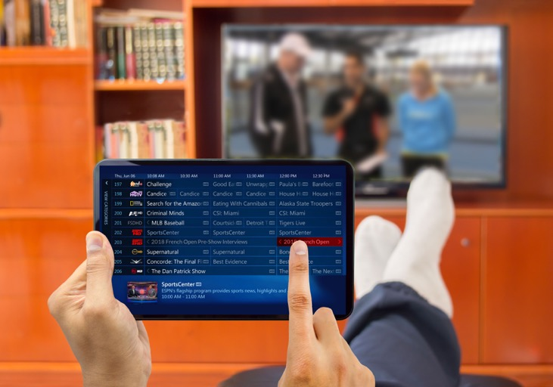



Digital Transformation Solutions
Access Networking
Media Distribution
Radio Broadcast
Global Services

Slide 14

Innovative Product Portfolio
ACCESS NETWORKING
MEDIA DISTRIBUTION
RADIO
Optical Transmission
Optical Hubs
Cable Gateways
Satellite Gateways
Headend Systems
Receivers
Network/Content Management
Monitoring/ Verification
Next-Gen Nodes
HFC Solutions
Broadband Gateways
Video Processing
SERVICES ATX CARE & ATX PRO
Warranty
Protection
Customer Care Support
Professional Services
Custom SLAs

Slide 15

Access Networking
Optical Transmission
Optical Hubs
Next-Gen Nodes
HFC Solutions

Slide 16
Optical Transmission
Optical Hubs
Next-Gen Nodes
HFC Solutions
High-performance optical access and HFC solutions that accelerate the analog-to-digital evolution
MODULAR
Plug-and-Play Architecture
Easily upgradable
COST-EFFICIENT
Reduces overall operational complexity
Integrates multiple standalone subsystems
FUTUREPROOF
Technology and protocol agnostic
Pay-as-you-grow business model

Slide 17
Skyrocketing Data Consumption Driving
Need For Gigabit-plus Broadband
INDUSTRY TRENDS
Data consumption growing at exponential rate
Constant technology upgrades and investments needed to meet demand
Analog-to-digital optics transition
Move to distributed architectures
ATX INITIATIVES
Driving fiber deeper into networks through analog-to-digital conversion, Remote-PHY and other distributed architectures
Cost-effective fiber reclamation in access network that supports pay-as-you-grow model
Agile Network Model that enables rapid technology adoptions
Global IP Traffic Growth / Top Line⁽¹⁾
Global IP traffic will increase 3-fold from 2016-2021
CAGR=24%
(1) Source: Cisco VNI Global IP traffic growth, 2016–2021

Slide 18





Accelerating the Digital Transformation
Distributed Access Architecture
Digital Optics
Hub Centralization
Virtualization
18 | ATX Confidential & Proprietary

Slide 19

Evolving Architecture
MSOs need to evolve existing HFC infrastructures to accommodate demand for gigabit-and-beyond broadband
Driving fiber deeper into network eliminates amplifiers and other actives, reducing cost and complexity and better positioning MSOs to deliver FTTX services
Replacement of analog optics with digital reduces costs and increases reach, wavelength provisioning and signal performance of existing fiber plant
Transition to DAA enables migration of headend equipment to virtualized environment, reducing power consumption and freeing up rack space in already overloaded centralized facilities
Centralized Access Architecture (CAA)
HEADEND
ANALOG TRANSORT
OUTSIDE PLANT & PREM
Internet Data
Voice
RF Manager
HFC Node
Linear Analog Optics
CMTS
RF Taps
BC Video
VOD & Other
QAMs
Distributed Access Architecture (DAA)
HEADEND
DIGITAL TRANSPORT
OUTSIDE PLANT & PREM
Multi-Service
Router / Switch
Digital Optics
Internet Data
Digital
Optics
DS PHY
DAC
10GE
US PHY
ADC
RF Taps
Audio
RPD/RMD Node
Video
QAM to IP
Virtual CCAP

Slide 20


SOLUTION: Distributed Access Architecture (DAA)
HEADEND
DIGITAL TRANSPORT
OUTSIDE PLANT & PREM
Multi-Service
Router / Switch
DLX Active
DLR Passive
Cell Backhaul
Remote PON OLT
MDU RPHY Shelf
Any Digital Optical DWDM Interface e.g. 1G / 10G / 40G / 100G
RF Taps
RPD/RMD
Nodes
CCAP
Agg. Switch
5G
FTTB
Edge QAMs
Core Video Network
Eliminates amplifiers and other active equipment in outside plant
Simplifies operational complexity of network
Replaces analog optics with cost-efficient optical Ethernet
Provides capacity growth to support gigabit-plus broadband services
Improves efficiency by extending optical-to-electric conversion deep in the network
Enables migration of headend equipment to virtualized environment, reducing power and freeing up rack space

Slide 21
SOLUTION: Hub Centralization
Reduces costs and operational complexity by eliminating the need for costly brick and mortar hub sites and street-side pedestals
Drives fiber deeper into the network to reduce network complexity and improve reliability
HEADEND
OPTICAL
TRANSPORT
HUB
OUTSIDE PLANT
Linear Analog
Optics
Internet Data
Voice
Linear Analog Optics
HFC
Nodes
BC Video
VOD & Other
RF Manager
RF
CMTS
RF Manager
RF
RF
Analog & QAM
BC Video
VOD & Other
FACILITY
SMALL HUB SITE
CENTRALIZED FACILITY
Field Mounted
Bi-Directional Transport
Network Distributed
HFC Nodes
Internet Data
Voice
RF
CMTS
Up to 40 WL/fiber 25 to >100 km
Mux / Demux
DWDM Optics
BC Video
VOD & Other
Analog & QAM

Slide 22
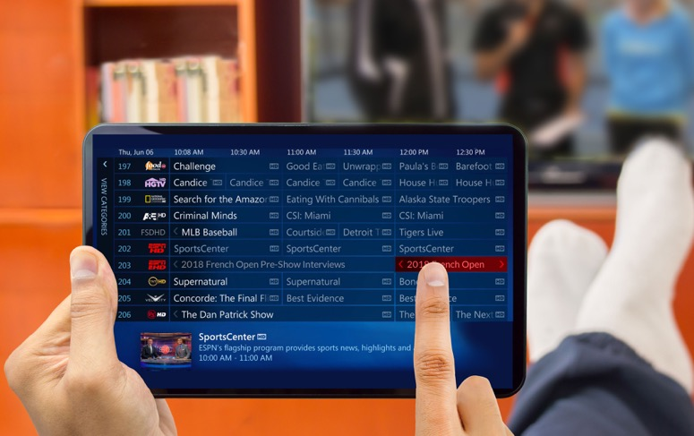
Media Distribution
Cable Gateways
Satellite Gateways
Broadband Gateways
Video Processing

Slide 23
Satellite Gateways
Cable Gateways
Broadband Gateways
Video Processing
Cost-effective and flexible distribution solutions designed to optimize the delivery and broadcast of media
MODULAR
Plug-and-Play Architecture
Easily upgradable
SECURE
Supports all major encryption technologies
Meets content owners’ strict requirements
COST-EFFICIENT
Reduces operational costs by several factors
Reduces costly maintenance and repairs

Slide 24
Expanding The Opportunity In Commercial Video Markets
INDUSTRY TRENDS
Residential subscribers cutting cord and moving to OTT
Strict security requirements for HD and higher-quality content
MDU market plagued by inefficient and operationally complex technology solutions
ATX INITIATIVES
Expanding the opportunity in commercial video markets
Support for all major encryption technologies
Reducing operational complexity and improving cost efficiencies
Top 5 Commercial Business Barriers
Antiquated Technology
Operational Overhead
Power & Rackspace Consumption
Maintenance Nightmares
Unsatisfactory Guest Experience
Top 5 Commercial Business Barriers
1
2
3
4
5
Source: PwC Consumer Intelligence Series video survey, 2017
© 2017 PricewaterhouseCoopers LLP, a Delaware limited liability partnership

Slide 25




Smart Buildings / Cities
Hotels
NEW TARGET
VERTICALS
Large Venues
Bringing home-viewing experience to out-of-home environments
Hospitals
Universities

Slide 26







SOLUTION: Bulk Video Distribution
DISTRIBUTION
COMMERCIAL PREMISES
(Hospitality, MDU, etc.)
CONSUMER
Satellite
Digital & Analog Television
Transmitter
Coax Network
Ethernet Network
Wi-Fi Network
Internet
IPTVs, Mobile Phones, Tablets, STBs
Cable
Secure Video to End-Consumer Devices
Provides secure delivery of satellite and cable content in MDU and hospitality locations
Reduces operational, installation and power costs typically associated with bulk video distribution
Supports ingest, decryption, conversion and distribution of multiple signal and stream formats
Futureproof design seamlessly accommodates technology changes and channel-count increases

Slide 27


Radio Broadcast
Headend
Systems
Receivers
Network/Content Management
Monitoring/ Verification

Slide 28

Headend
Systems
Receivers
Network/Content Management
Monitoring/ Verification
Market-leading solutions for delivery, scheduling and playout of live or pre-recorded audio to radio stations around the world
FLEXIBLE
Compatible with satellite or terrestrial distribution
Right-sized for both small and large radio networks
SIMPLE/EASY TO USE
Open APIs provide third-party interoperability
Web-based control system automates scheduling, delivery and management
REDUNDANCY
Built-in geo-redundancy and automatic failover
Monitoring and alarming ensure 24/7 business continuity

Slide 29

Dominating The Market With The Most Innovative, Advanced, Cost-Effective Broadcasting Platform
73 COUNTRIES
15K RADIO STATION DEPLOYMENTS
1M ADS MANAGED PER WEEK
30K
RECEIVERS
INSTALLED

Slide 30





SOLUTION:
Radio Content Management, Distribution & Monitoring
NETWORK HEADEND OR HUB
AUDIO & DATA DISTRIBUTION
NETWORK STATIONS OR AFFILIATES
AM/FM
Live or Recorded
Programming
4 Audio Ports
Headend System
www
AM/FM/HD Audio Monitoring Receiver
Network & Content Management System
AM/FM
1 Audio Port
Complies with updated FCC rules on local market requirements
Uses “Store-and-Forward” technology to increase distribution efficiency
Increases reliability and accountability
Web-based centralized control and content management capabilities
Reduces cost of maintaining hardware, software, sales and technical resources in each market
Extends reach of account managers

Slide 31

Global Services
Warranty
Protection
Customer Care Support
Professional Services
Custom SLAs

Slide 32
Warranty
Protection
Customer Care Support
Professional Services
Custom SLAs
Highly customized solutions for business resiliency and operational efficiency
COMPREHENSIVE
Standard, Select and Premium support tiers
Network design, project management, EF&I and remote SME professional services
RELIABLE
24/7/365 responsiveness for guaranteed business continuity
95% response target
FORWARD LOOKING
Custom SLA Targets
Emergency On-site support

Slide 33

ATX Care
Premier
Business Day Tech Support
Client Support
Monthly Reviews
Platform Health Check
24x7 Emergency Support
Full Outage RCA
Advanced Replacement (Next Business Day Ship)
Software Updates
SW Update Baseline Review
Knowledge & Bulletins
Basic Overview guides
1 Platform Software Upgrade per year
Select
Business Day Tech Support
Client Support
Quarterly Reviews
24x7 Emergency Support
Full Outage RCA (w/ poss)
Advanced Replacement (5 Business Day Ship)
Software Updates
SW Update Baseline Review
Knowledge & Bulletins
Basic Overview Guides
Standard/Warranty
Business Day Tech Support
Return & Repair of Parts
Software Updates
Knowledge & Bulletins

Slide 34
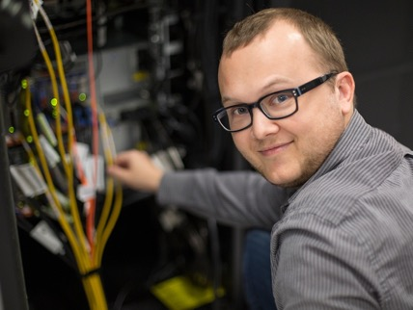
ATX Pro
ATX’s suite of professional services enables our customers to augment their resources, adding highly skilled, product-centric knowledge and scalable workforce to meet the dynamic demands.
Installation Support/Equipment Removal
Configuration Assistance
Network Consultancy
Troubleshooting Outside of ATX Equipment
On-Site Support
Network Redesign
Training
Project Management

Slide 35






We are ATX
Diverse worldwide customer base
Heritage of innovation and accountability
Agility and nimbleness to deliver optimized solutions
Meaningful and strategic organic and inorganic growth
Sustained history of delivering customer satisfaction
Go-to-market models that maximize internal resources and partner community

