Slide 2
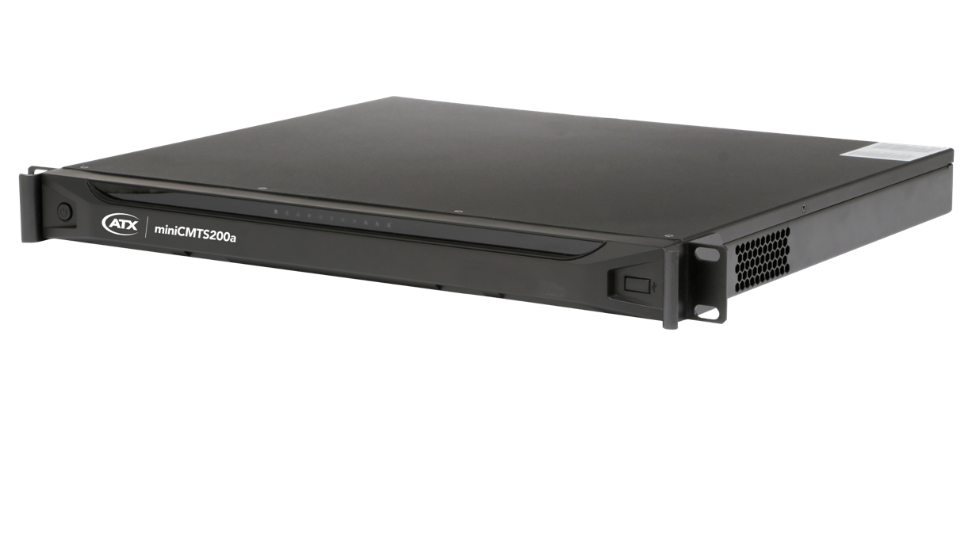
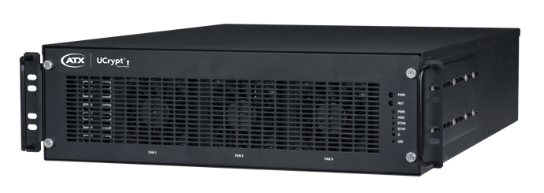


Bulk Media Delivery

Slide 3
UCRYPT CABLE GATEWAYS
Media Distribution Gateways

Slide 4
UCrypt® Cable Gateways
Support an industry-leading number of ingest, output and security formats
Enable operators to deliver video services to MDU environments
Eliminate need for set-top boxes (STBs) at each end point

Slide 5








UCrypt Cable Gateways
Key Application:
Bulk Media Distribution
DISTRIBUTION
COMMERCIAL PREMISES
(Hospitality, MDU, etc.)
CONSUMER
Satellite
Digital & Analog Television
Transmitter
Coax Network
Ethernet Network
Wi-Fi Network
Internet
IPTVs, Mobile Phones, Tablets, STBs
Secure Video to
End-Consumer Devices
Cable

Slide 6
Key Features
Supports SPTS and MPTS output formats over multicast or unicast
Supports HD/SD, MPEG-2 or H.264 program streams
Output in Pro:Idiom® encrypted, Verimatrix® encrypted, AES128 Fixed Key encrypted or clear IP streams
Includes configurable EPG (Electronic Program Guide) channel
Allows for PSIP VCT insertion for virtual channel mapping
Supports MediaCipher®, PowerKEY® or NDS® CableCARD™ based decryption
Support for SCTE-18 EAS override functionality

Slide 7
Key Features
Supports QAM carrier demodulation containing complete multiplexes of encrypted streams from a cable plant and conversion of the multiplexes for retransmission using the MUX Pass Through QAM to IP mode
Field-upgradeable for channel capacity expansion
Easy-to-use, web-based UI for remote configuration, management and monitoring
Proactively mass-monitorable via ATXs UCrypt Monitoring Server

Slide 8

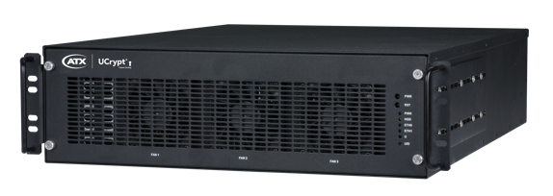

Key Benefits
Operational Efficiency – MSOs can reduce costs and operational overhead by streamlining operations for transitioning, and re-encrypting digital IP multicast feeds to other formats
Content Security Compliance – Enables both transport link security (AES128) as well as industry ratified encryption within hospitality & commercial properties for service provider adherence to their content license agreements
Reduced Trouble Calls – Proven track record of long-term operation in mission-critical and high-visibility environments with multiple layers of integrated redundancy and robustness

Slide 9
Key Benefits
Ease of Deployment – Enterprise-grade features, such as remote configuration and monitoring capability, including the ability to pro-actively monitor deployed devices via a central UCrypt Monitoring Server instance, makes it easier for MSOs and other service providers to keep tabs on the health of their networks
Cost Efficiency – Superior processing capacity at competitive pricing allows service providers to meet their required ROI for servicing commercial and hospitality accounts

Slide 10
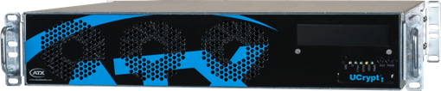
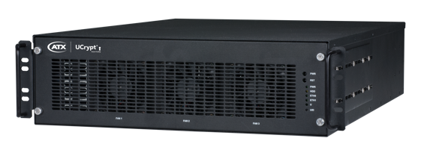
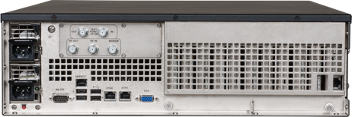
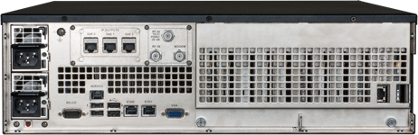
UCrypt Cable Gateways – QAM Inputs
QAM to QAM
QAM to IP
QAM to Analog

Slide 11




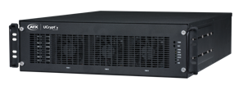
Key Application: QAM to QAM
MDU / Hospitality / Healthcare
Multifunction Capabilities
  Most efficient solution for decrypting and transitioning an encrypted digital cable feed to Pro:Idiom encrypted or clear QAM video format
  Suitable for hospitality, enterprise and other bulk account applications
Maintain Business Continuity
  Field hardened, proven track record in mission critical, long-term operations and high-visibility MSO locations
Enterprise-Grade Features
  Remote configuration and monitoring capability (Including the ability to pro-actively monitor all deployed devices via a central Monitoring Server)
Highest Density
  Industry-leading support for handling up to 60 MPEG-2/H.264, HD/SD, programs in a single unit
QAM TVs
QAM TVs/STBs
UCrypt QAM to QAM
Clear / Encrypted MSO QAM
UCrypt Encrypted QAM Output or
UCrypt Clear QAM Output

Slide 12
Key Application: QAM to IP
MDU / Hospitality / Healthcare
Multifunction Capabilities
  Most efficient solution for decrypting and transitioning QAM-based cable feeds to IP video format
  Suitable for hospitality, enterprise and other bulk account applications, including multiple options for output IP video encryption
Maintain Business Continuity
  Field-hardened, proven track record in mission-critical, long-term operations and high-visibility MSO locations
Enterprise-Grade Features
  Remote configuration and monitoring capability (Including the ability to pro-actively monitor all deployed devices via a central Monitoring Server)
Highest Density
  Industry-leading support for handling up to 60 MPEG-2/H.264, HD/SD, programs in a single unit
Smart Hospitality TVs
IP STBs
UCrypt QAM to IP
Clear / Encrypted MSO QAM
UCrypt Encrypted IP Output or
UCrypt Clear IP Output

Slide 13

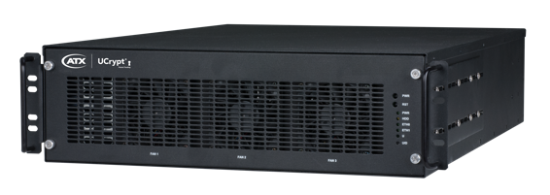

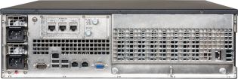
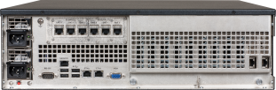

UCrypt Cable Gateway – IP Inputs
IP to QAM
IP to IP
IP to Analog

Slide 14


Key Application: IP to QAM
MDU / Hospitality / Healthcare
IP to RF Transitioning & Content Security
  Delivery of Pro:Idiom encrypted QAM-based streams directly to Pro:Idiom capable commercial TVs for properties fed with IP source streams
  Maintaining content protection to the display on HD programming in commercial properties is typically a contractual requirement for service providers
Direct Fiber or Node Connections
  Where the end customer is connected directly via fiber or dedicated node to the headend or hub, the IP to QAM can be centrally located to leverage multiple customers using the same source feed & lineup
QAM TVs
QAM TVs/STBs
IP Network
Legend:
Clear / Encrypted MSO IP feed
UCrypt IP to QAM
UCrypt Encrypted QAM Output or
UCrypt Clear QAM Output

Slide 15


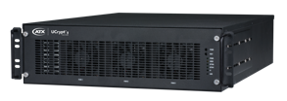
Deployment Example – IP to IP
Ideal for MSOs wanting to create and leverage a dedicated channel lineup with secure content for multiple commercial and hospitality clients
  Consolidates Pro:Idiom or AES-128 Fixed Key encryption for IP multicast or unicast streams intended for delivery over an IP based transport to downstream equipment (such as edgeQAMs) or direct to end customers networks over direct fiber or dedicated links
As a multiplexer/demultiplexer at the headend or edge
  This enables MSOs to select specific programs from their lineup, encrypt them with Pro:Idiom, AES-128 Fixed Key, or leave them in the clear, then distribute them within their network (i.e. MPTS to SPTS conversion with program ‘cherry picking’)
MDU/Hospitality/Healthcare
Legend:
Headend/Hub
MSO IP Network Feed
IP Encrypted/Clear Output
IP Network
IP to Analog
Analog Output
QAM RF Output
IP to IP
Bulk Encryptor
IP to QAM

Slide 16
miniCMTS200a
Cable Modem Termination Solution

Slide 17
miniCMTS200a
The low-cost miniCMTS delivers exceptional value for small-scale deployments, including MDUs and is optimized to support up to 400 cable modems*.
* Maximum of 250 DOCSIS® 3.0 plus 150
DOCSIS 2.0, or 400 DOCSIS 2.0

Slide 18
miniCMTS200a
Provides internet access via existing coax cables
Alternative to Larger and 2nd-hand CMTSs
Targeting Hospitality, MDU, Small Cable Systems, Campus
Internet
Ethernet
Coax
CMTS
HFC
Coax
CM
CM
CM
Ethernet
PC
PC
PC

Slide 19
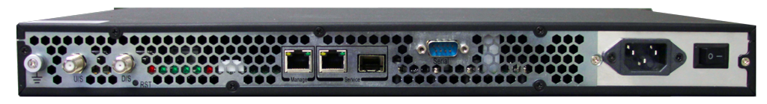
Product Overview – miniCMTS200a
Supports 400 DOCSIS Cable Modems
  250 3.0 + 150 2.0 or 400 2.0
16 Downstream QAM Channels
  800 Mbps
  87 to 1000 MHz
4 Upstream QAM Channels
  120 Mbps
  5 to 65 MHz
QOS, Dynamic Load Balancing, BPI+ Security, and Upstream Scheduling (Best Effort, UGS, UGS/AD).
DHCP Relay
RJ45 or SFP for Data
Highly intuitive User Interface

Slide 20

Key Features – miniCMTS200a
Optimized for smaller cable operators
Supports up to 400 DOCSIS cable modems
Offers 16 downstream bonded channels
Offers 4 upstream bonded channels
Provides high-speed data delivery: 800 Mbps downstream and 120 Mbps upstream
Features an intuitive web interface for simple configuration, management, and debugging

Slide 21

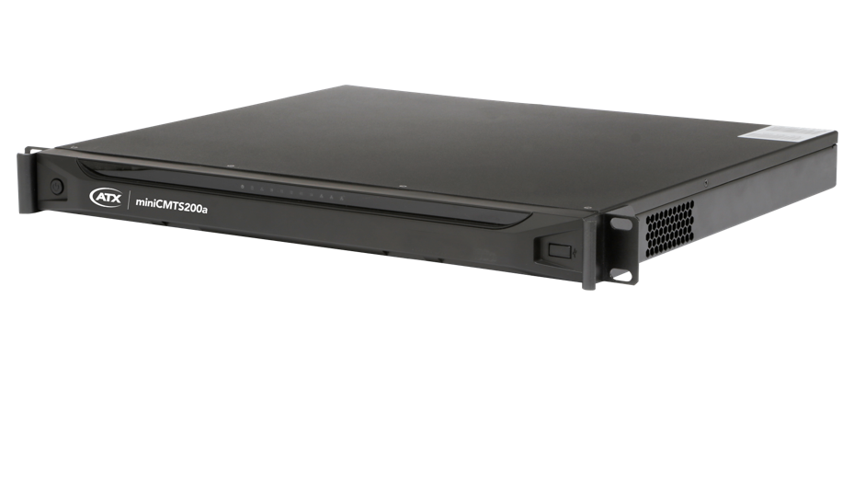

Key Benefits
Capital Costs Savings – The miniCMTS200a is right-sized for the small operator, delivering exception value by supporting up to 400 cable modems at a fraction of the cost of systems designed for larger subscriber bases.
Reduced Operational Overhead – Equipped with an intuitive Web interface for simple configurations, management and debugging, the ATX miniCMTS saves service providers time and operational resources that could be dedicated to other tasks

