Slide 2
CHANNEL INSERTION Advanced Encoding Solutions

Slide 3
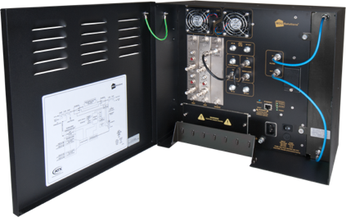
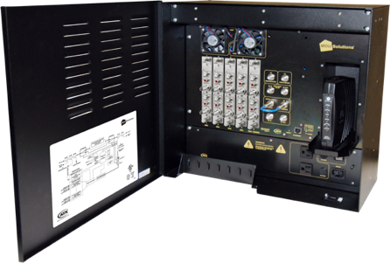

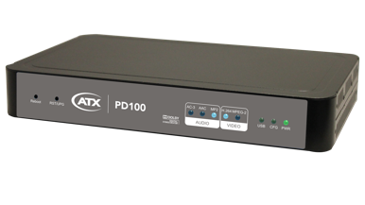

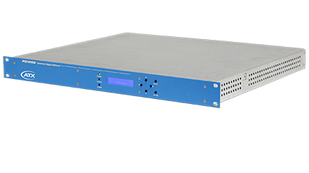


Advanced Encoding Solutions
Designed to convert on-premises-generated video content to digital formats that can be viewed by digital televisions and digital-only STBs

Slide 4




DVIS Encoding Solutions
QAM Filtering &
Add/Drop Capability
Full RF Spectrum
Including Inserted Program
STB
Full RF Spectrum
OR
Local Content
Band-Edge or Blank QAM Insertion
STB
Full RF Spectrum
Full RF Spectrum
Including Inserted Program

Slide 5


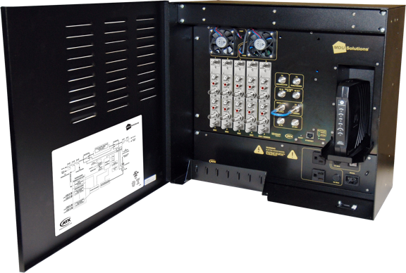

Product Overview – DVIS
2 sizes
DVIS (5 card slots)
DVISm (3 card slots)
Wall-mounted
Hardened enclosure for MDU, hospitality, & enterprise sites without a secure server room
Secure
Lockable door
Low Cost
Remote Management
Integrated web-based GUI
Integrated with the ATX Monitoring Server

Slide 6

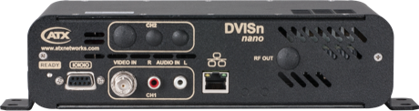
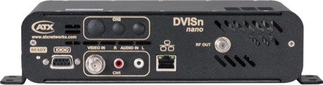
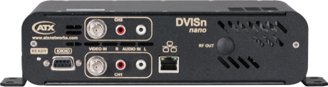
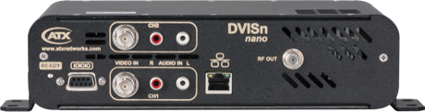
Product Overview – DVISn (Nano)
Low-Cost MPEG-2 SD Encoding
IP or QAM output
Scalable 1 to 2 Channels
Ultra Compact Form Factor
Wall-mountable solution
No Cards Needed
Remote Management
Integrated web-based GUI
1ch, IP OUT
1ch, RF OUT
2ch, IP OUT
2ch, RF OUT

Slide 7
Key Features - DVIS
Integrated QAM channel deletion filter
Supports 1- and 2-channel encoder cards for easy unit expansion to handle additional programs
Supports both HD and SD encoder cards within the same chassis
Fully integrated QAM modulator with agile wideband RF upconverter (15-975 MHz)
QAM demodulator card available for QAM processing functionality
Accommodates any digital insertion methodology: blank QAM, locally deleted QAM and “add/drop” of program(s) within a QAM

Slide 8
Key Features - DVIS
RF bypass switch bypasses deletion filter and restores original QAM in case of power failure or unit reboot
Dynamic PID monitoring prevents outages due to PSI changes within the transport stream
Externally accessible plug-in cards for ease of upgrade and maintenance
Optical transmitter module available for insertion into FTTX architectures
HTTP-based GUI allows for easy set-up and control using a standard web browser
Remote access and SNMP monitoring available via integrated RJ45 Ethernet interface

Slide 9


Key Benefits - DVIS
Pay-As-You-Grow Model – Modular architecture allows service providers to purchase and install functionality in alignment with end-user demands, using different cards for different input types or additional hardware in the future at an incremental cost
Broad Market Applicability – Flexibility to support installation at hospitality, campuses, stadiums, airports, and enterprise locations enables service providers to service a broad customer base with the same equipment and skill sets

Slide 10
Key Benefits - DVIS
Flexibility and Expandability – Supports wide breath of digital insertion methodologies and multipurpose-nature reduces costs and simplifies upgrades by centralizing all features in one box with front access to all modules and connections
Ease of Deployment – HTTP-based GUI allows for easy set-up and control without the need for proprietary software installation
Integrated Add/Drop Functionality – Optional plug-in demodulator card reduced operational complexity through easy insertion of programs into an existing QAM, clear or encrypted stream, allowing for the replacement of only the desired programs

Slide 11

Key Application: Insertion Into an Open or Band-edge QAM
LOCAL CONTENT AVAILABLE IN NEW QAM EIA 129
QAM
125
QAM
126
BLANK
127
QAM
128
QAM
125
QAM
126
QAM
127
QAM
128
QAM
129
RF Spectrum Input
RF Spectrum Output
QAM
129
MPEG Encoder
TS Multiplexer
QAM Modulator & RF Upconverter
Local Content
Analog CVBS Format

Slide 12
Key Application: Add/Drop Capabilities
DROP PROGRAM(S) FROM A SELECTED QAM
LOCAL CONTENT RE-INSERTED INTO QAM IN PLACE OF DROPPED PROGRAM
QAM
125
QAM
126
BLANK
127
QAM
128
QAM
125
QAM
126
BLANK
127
QAM
128
RF Spectrum Input
RF Spectrum Output
QAM 128 Channel Deletion Filter
QAM Demodulator
QAM
127
Local Content
Analog CVBS Format
MPEG Encoder
TS Multiplexer
QAM Modulator & RF Upconverter

Slide 13
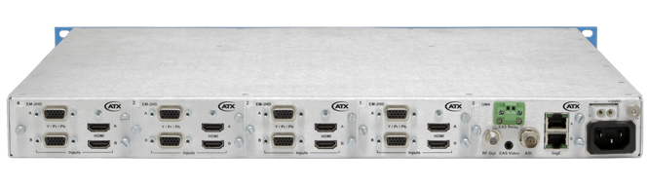
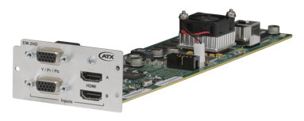
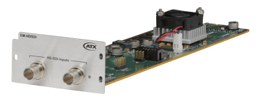
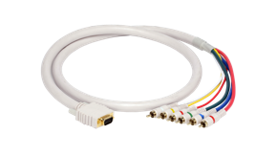
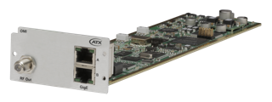
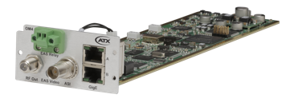
Product Overview – PD1000
Up to 8 SD/HD Programs Per Unit
Dual-Input Module: HDMI, Component, Composite
Dual-Input Module: HD-SDI
Output Module: QAM & IP (Optional)
Output Module: ISDB-T & ISDB-Tb
MPEG-2 & H.264 Video Compression
MPEG-1 Layer II/AC3 Dolby Audio
EAS Input/Closed Caption
Local/Remote Management
External DC Power Backup (Optional)
Fully Loaded 8 Channel H.264/MPEG-2 HD/SD Encoder
EM-2HD MPEG-2 or H.264 Dual HD Encoder Module
EM-HD-SDI HD-SDI Input Module
OMI/OMI-Tb ISDB-T & ISDB-Tb Output Modules
OM4 QAM Output Module

Slide 14
Key Features – PD1000
Platform-based encoder with up to four field-upgradeable, dual-channel encoder modules
Supports 480i to 1080p real-time encoding and up to 8 HD video sources in MPEG-2 or H.264 formats, all in 1RU
No change of resolution between input and output
Integrated support for Emergency Alert System (EAS)
Automatic detection of input type and format
Outputs four consecutive QAM RF channels or two consecutive ISDB-T or ISDB-Tb RF channels with up to four ISDB-Tb RF channels per chassis

Slide 15
Key Features – PD1000
IP output: Unicast/Multicast, RTP/UDP/IP, RTSP and SPTS
PSIP tables allow users to configure virtual channel maps for each channel
High output power with 53 dBmV max., combined
Secure management and configuration via an easy-to use to use web browser
External DC backup power supply

Slide 16


Key Benefits – PD1000
Timely Technology Refreshes The software-upgradable nature of PD1000 protects service providers against technology obsolescence, ensuring they are able to offer is able to seamlessly incorporate new features and technologies as they become available, without frequent hardware upgrades
Operational Efficiency and Space Savings Supports multiple formats in a single rack unit, enabling service providers to conserve valuable rack space and reduce power consumption

Slide 17
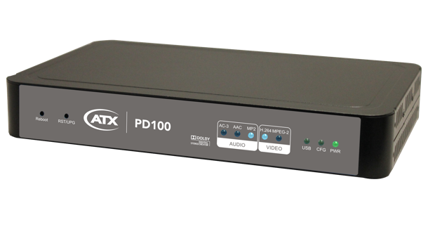


Product Overview – PD100
Single-Channel HD IP Encoder
Input: HDMI, Component, Composite
Output: IP
IP: UDP/RTP Multicast/Unicast
Video: MPEG-2/H.264 Compression
Audio: MP1 II, AAC, AC-3 2.0 Encode
Audio: 5.1 Pass Thru
Local/Remote Management
Closed Caption
TCP / UDP / RTP
HDMI / YCbCr / CVBS
Network Switch / Wireless AP

Slide 18



Key Features – PD100
HDMI, component, and composite inputs with auto detection
Dual mode: H.264/MPEG-2 selectable
Video resolution: Up to 1080p
Audio format: MPEG-1 Layer II
AC-3 2.0 encode & 5.1 pass through
Easy installation and use
Web GUI for setup and control
IP output
Closed caption supported

