Slide 2
DISTRIBUTED ACCESS ARCHITECTURE

Slide 3


Distributed Access Architecture (DAA)
HEADEND
DIGITAL TRANSPORT
OUTSIDE PLANT & PREM
Multi-Service
Router / Switch
DLX Active
DLR Passive
Cell Backhaul
Remote
PON OLT
MDU RPHY Shelf
Any Digital Optical DWDM Interface
e.g. 1G / 10G / 40G / 100G
RF Taps
RPD/RMD
Nodes
CCAP
Agg. Switch
5G
FTTB
Edge QAMs
Core Video Network

Slide 4
GIGAWAVE DIGITAL OPTICAL GATEWAY
Next-Gen DWDM Transport Solution

Slide 5


GigaWave Digital Link Extender (DLX)
Powerful, futureproof and protocol-agnostic solution for expanding the capacity of fiber access links in a cost-effective and pay-as-you-grow manner

Slide 6
GigaWave DLX40 Solution
Key Applications:
DAA - 10GE RPD / RMD
10GE PON OLT
1GE / 10GE FTTB
Cell backhaul
5G backhaul
Beyond 10GE
HEADEND
DIGITAL TRANSPORT
OUTSIDE PLANT & PREM
Multi-Service
Router / Switch
DLX Active
DLR Passive
Cell Backhaul
Remote
PON OLT
MDU RPHY Shelf
Any Digital Optical DWDM Interface
e.g. 1G / 10G / 40G / 100G
RF Taps
RPD/RMD
Nodes
CCAP
Agg. Switch
5G
FTTB

Slide 7
Key Features
High level of integration maximizes rack space
density and lowers power consumption
Optimized OSNR maintained in DS and US
High dynamic range and sensitivity
Fast optical switching time if fiber cut
SNMP/WEB GUI support
US/DS monitor ports and PON express ports
Two DLX40 modules per redundantly powered 1-RU chassis
Supports up to 20 RPD/RMD nodes
1625nm OTDR insertion port optional at each output
Paired with all-passive outside plant equipment - Digital Link Receiver (DLR)

Slide 8


Key Benefits
Supports Distributed Architecture – Enables reliable and fiber-efficient Remote-PHY (R-PHY)-based fiber deep node deployments
Optimized Fiber Utilization – Transmit up to 40 US/DS 10 GigE optical links redundantly across two fibers
Advanced Resiliency – Automatically supported redundancy across varying fiber distances ensures continuous operations
Operational Efficiency – No actives in field increases reliability and decreases Opex (truck rolls/powering)
Increased Revenue – Supports fiber-deep architectures using same fiber assets or reclaims fiber for additional revenue-generating services
Futureproof – Content- and protocol-agnostic transport solution enables seamless adoption of new technologies

Slide 9
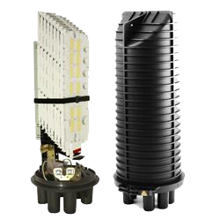
Operational Efficiency
Simplifies Operations for Technicians
  Auto-level adjustment between primary and secondary paths
  No routing protocols
  Integrated EDFA Post/Pre-amp, Optical Switch and Passives Module
  Reduces insertion losses
  Eliminates interconnecting multiple devices, reduces rack space and devices to manage
DLX Active
DLR Passive
Up to 20 RPD/RMD Nodes
OS

Slide 10



Key Application: Migrating to DAA
Headend RF modulation is eliminated and CMTS functions split between the headend and node (RPD) or completely moved to the node (RMD)
Linear analog optics replaced with digital optics e.g 10 Gigabit Ethernet
Centralized Access Architecture (CAA)
HEADEND
ANALOG TRANSORT
OUTSIDE PLANT & PREM
Internet Data
Voice
RF Manager
HFC Node
Linear
Analog Optics
CMTS
RF Taps
BC Video
VOD & Other
QAMs
Distributed Access Architecture (DAA)
HEADEND
DIGITAL TRANSPORT
OUTSIDE PLANT & PREM
Multi-Service
Router / Switch
Digital
Optics
Internet Data
Digital
Optics
DS PHY
DAC
10GE
US PHY
ADC
RF Taps
Audio
RPD/RMD Node
Video
QAM to IP
Virtual CCAP

Slide 11
Key Application: Reducing Service Areas
250-500 Homes Passed
N+0 | 32-64 Homes Passed | Supports FDX
RF Taps
40ch
DWDM
RPD/RMD
Nodes
10GE
RF Taps
Agg. Switch
RPD/RMD
Node
Agg. Switch
DWDM
40ch
RF Taps
Single node becomes 10-20 nodes depending on density
Additional Services
Business
Cell Backhaul
5G

Slide 12
UCrypt PassPort Gateway
Accelerating Adoption of DAA

Slide 13
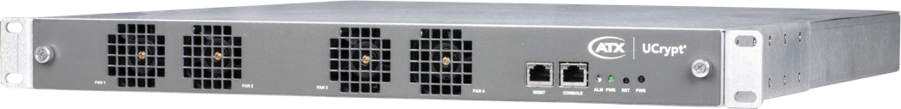

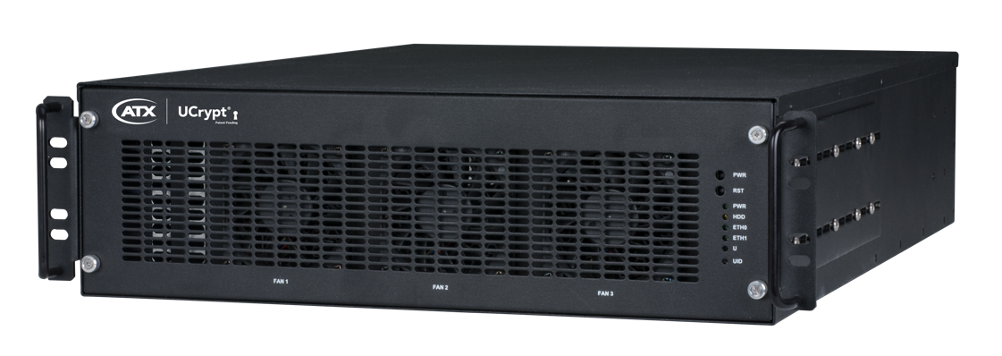
UCrypt RF R-PHY Gateways
Providing a mux passthrough function
Enabling cable operators to maintain existing video encryption functionality on in-service edge QAMs
Alleviating the need to migrate encryption functionality to the CCAP video core during early stages of DAA transition

Slide 14
UCrypt RF R-PHY Gateway
Key Applications:
Legacy QAM Mux to IP Conversion
Legacy QAM Mux to DEPI Conversion
HEADEND
DIGITAL TRANSPORT
OUTSIDE PLANT & PREM
Multi-Service
Router / Switch
DLX Active
DLR Passive
Cell Backhaul
Remote
PON OLT
MDU RPHY Shelf
Any Digital Optical DWDM Interface
e.g. 1G / 10G / 40G / 100G
RF Taps
RPD/RMD
Nodes
CCAP
Agg. Switch
5G
FTTB
Edge QAMs
Core Video Network

Slide 15
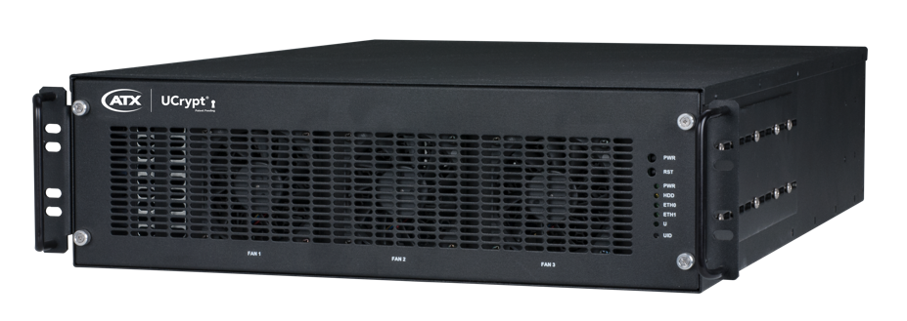
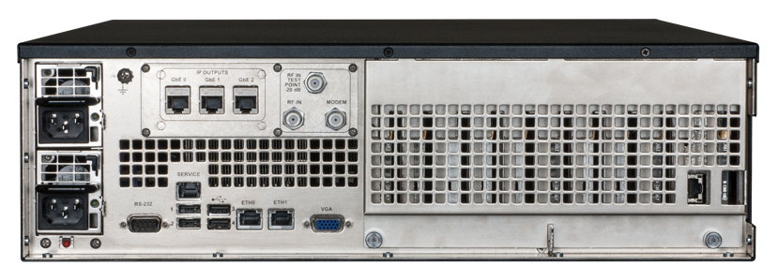
Key Features – UCrypt Mux-Passthrough Q2IP
60 & 78 QAM models available
Conversion of entire QAM content to IP
  Including private PIDs and other non-video related PIDs and packets
Individually agile tuners
Optional 1/10Gbps SFP interface
Redundant AC or DC power supply option
Enterprise-grade features and robustness
  SNMP- and Telemetry-based monitoring support, advanced access controls and security, available API-based configuration
Mux-Passthrough Q2IP

Slide 16
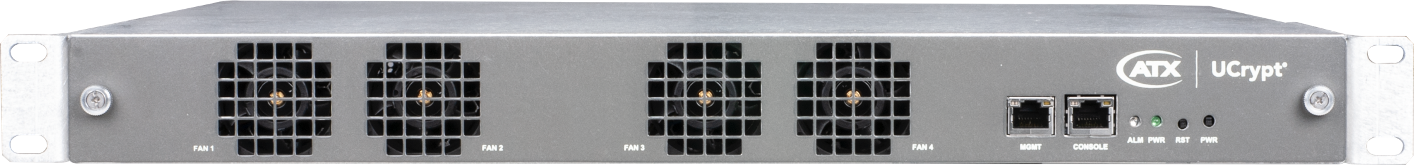
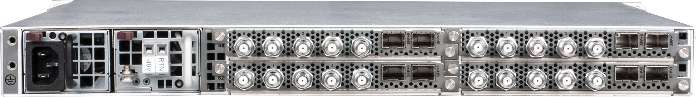
Key Features – UCrypt PassPort
Total capacity of up to 320 processed QAMs in 1RU
Modular design can be purchased and populated with 1 to 4 demod cards per 1RU chassis
Supports multiple selectable operating modes to accommodate various broadcast and narrowcast architectures
Redundant AC/DC power supplies

Slide 17
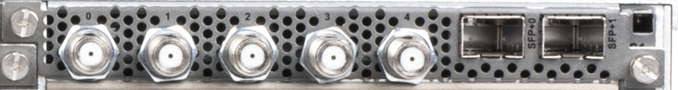
Key Features – UCrypt PassPort
Demod Card Features & Specifications
Tune, demodulate and convert up to 80 QAMs on a single card
  Broadcast-80 mode: single RF input, up to 80 QAMs processed
  Broadcast-40 mode: 2 RF inputs, up to 40 QAMs processed each
  Narrowcast mode: Up to 5 RF inputs of up to 16 QAMs each
Support for tuning QAM Annex A, B & C based carriers
2 x 10 Gbps SFP-based IP output ports per card (for output and management)

Slide 18
Key Features – UCrypt PassPort
Redundancy Support
Demod cards operate completely independently
Each card can be configured, managed and monitored as a separate entity (with unique management IP address and UI/API instance)
Cards can be managed via cloud-based element manager application
Cards are hot-swappable and one card being removed or going down has no effect on other cards
No shared common resources or points of failure
Only shared operational component within chassis is a passive power distribution backplane

Slide 19



Key Benefits – UCrypt PassPort
Accelerates DAA Deployments – Reduces DAA deployment complexity by alleviating the need to re-configure all video muxes and parameters in the CCAP video core and integrate the CCAP video core into back-office systems
Delivers Cost Efficiencies – Modular design enables MSOs to align resources and product capabilities with real-world demand and to upgrade on a pay-as-you-grow model
Improves Operational Efficiency – Support for a wide variety of broadcast and narrowcast operating modes allows for maximizing the efficiency of the equipment’s capacity according to the video lineup architecture

Slide 20
Key Benefits – UCrypt PassPort
Saves Rack Space – Industry-leading density of up to 320 QAMs in a single rack unit enable MSOs to conserve precious headend real estate and reduce power consumption
Loosens Proprietary Constraints – Platform’s agnostic nature expands universe of potential equipment suppliers by freeing up MSOs to deploy equipment from any CCAP provider, without fear of encountering encryption/decryption compatibility issues with the installed base of set-top boxes (STBs) and other subscriber equipment
Provides Peace of Mind – Advanced redundancy support provides MSOs with the confidence that critical services will operate without disruption,
even in the case of hardware failure

Slide 21
Key Application: QAM Mux to IP Conversion
RF R-PHY Gateway to CCAP Video Core
HEADEND
DIGITAL TRANSPORT
OUTSIDE PLANT & PREM
Core Video Network
Edge QAMs
RF Taps
Multicast/Unicast IP UDP Streams via 10Gbps/1Gbps fed to CCAP Video Core
R-PHY
Nodes
Combined RF Input with encrypted video muxes fed to PassPort
SFP+
Converged Interconnect Network
(CIN)
RF Taps
SFP+
R-PHY
Nodes
CCAP
RF Taps
R-PHY
Nodes

Slide 22
Key Application: Legacy QAM Mux to DEPI Conversion
RF R-PHY Gateway as Auxiliary CCAP Video Core
HEADEND
DIGITAL TRANSPORT
OUTSIDE PLANT & PREM
Core Video Network
Edge QAMs
Core Data
Network
RF Taps
Multicast/Unicast IP UDP Streams via 10Gbps/1Gbps fed to CCAP Video Core
R-PHY
Nodes
Combined RF Input with encrypted video muxes fed to PassPort
Converged Interconnect Network
(CIN)
RF Taps
R-PHY
Nodes
CCAP
DEPI-encapsulated streams via 10Gbps/1Gbps fed to CIN
RF Taps
R-PHY
Nodes

