Slide 2
DAA-Optimized Optical Node Forward-Looking & Futureproof

Slide 3
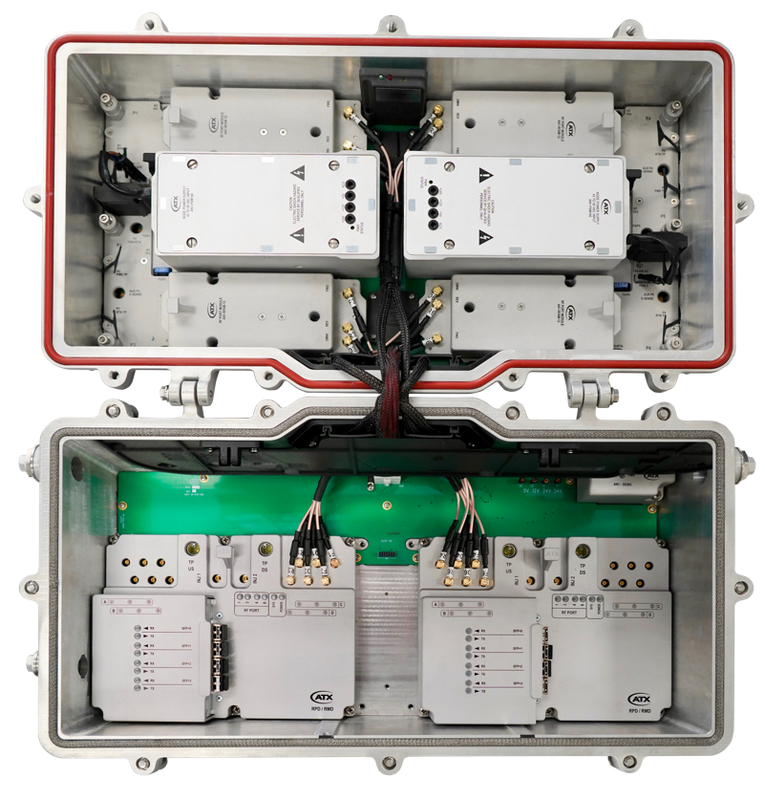


DAA-Optimized Node
Forward-looking, futureproof solution that enables MSOs to begin to capitalize on the capabilities of Distributed Access Architecture (DAA) and digital technologies, while seamlessly accommodating future technologies and architectures as they become available

Slide 4
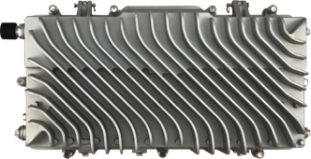


New Housing Features
Purpose Built to Support DAA and Future Technologies
Supports 2 GHz “Extended Spectrum DOCSIS”
Supports for Full Duplex DOCSIS
Designed to dissipate >180 Watts
Diagonal External Fin Design - optimized heat dissipation in any mounting orientation
Four RF/AC ports and two AC/Local insertion ports
Forward/Return test points on each RF port
Multi-function adapter port for future applications
(e.g. WiFi, 5G)
LH Side
AC / RF Local Insertion
Fiber Entry
Ports
Multi-function
Adapter Port
AC / RF Ports
FWD/RTN
Test Point
RH Side

Slide 5

Node Configuration
Four Independent RF Modules
Only populate active ports for cost savings
High output level - 58 / 37 dBmV 1218 / 105 MHz referenced to QAM (64 / 43 “virtual”) with DPD power reduction
Plug-in diplex filters (standard split frequencies)
All Electronic Attenuators & Equalizers
Eliminate plug-ins
Support auto-alignment & remote control
Dual Redundant High-Efficiency Power Supplies
Supports Up To Two RPD/RMD Modules with Analog RF Overlay Option

Slide 6
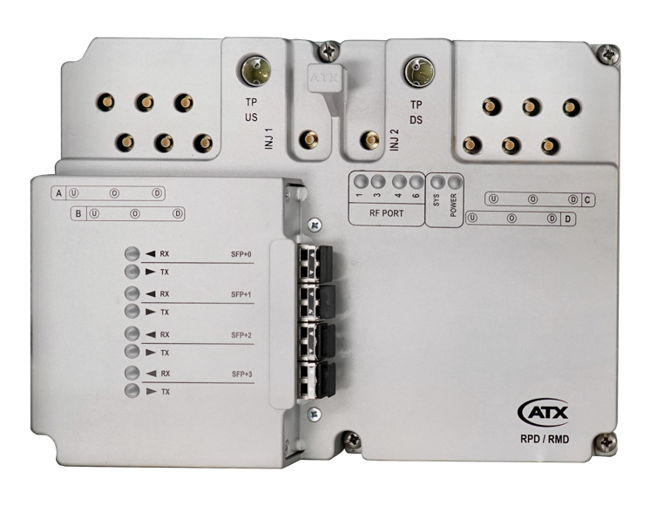
RPD/RMD Module - Interfaces
Four Discrete Forward and Return Path RF Interfaces
Eliminates RF configuration/combining modules
Segmentation configured in digital domain
Four Discrete Performance Monitor Ports
Per port Digital Predistortion (DPD) to optimize each individual forward path hybrid
DOCSIS PNM Full-band Capture 5 to 1218 MHz
On-board spectrum analysis supports auto-alignment
Up to Four SFP+ Interfaces Supporting Daisy Chain
Forward and Return Path Test Points
LED Diagnostics
System & Power status, SFP activity, RF Port enabled

Slide 7
RPD / RMD Module – Segmentation Capacity
Downstream 1 or 2 service groups with combination of the following per service group:
Six 192 MHz OFDM channels
160 SC QAM channels
10 OOB channels & 16 tone generators
Upstream 1, 2 or 4 service groups with combination of the following per service group:
Up to 199 MHz per service group
Two 96 MHz OFDMA channels
24 ATDMA or 16 ATDMA + 8 SCDMA channels
6 OOB channels

Slide 8
Node Management
CM-SP-R-OSSI compliant for RPD module configuration
Secure Auxiliary Core application to support traditional node MIB functions
SCTE HMS monitoring MIBs
DOCSIS PNM MIBs
RF configuration and auto-alignment
Barcode inventory scan
Disable unused RPD/RMD module functions for power savings

