Slide 2
I-HUB OPTICAL HUB Hub Centralization/Elimination Solution

Slide 3

I-HUB
Next-generation, field-hardened optical platform
Capable of supporting both analog and digital optics,
Enables operators to supports a variety of architectures and expand the capacity and reach of existing fiber plant

Slide 4



I-HUB Field-Hardened Optical Hub
HEADEND
OPTICAL
TRANSPORT
HUB
OUTSIDE PLANT
Key Applications:
Hub Centralization/ Elimination
Node Splitting/ Segmentation
FTTX
Business Services
Internet Data
Voice
Linear Analog Optics
HFC
Nodes
Linear Analog Optics
BC Video
VOD & Other
RF Manager
RF
CMTS
RF Manager
RF
RF Taps
Analog & QAM
BC Video
VOD & Other
FACILITY
SMALL HUB SITE
Field Mounted
Bi-Directional Transport
Network Distributed
CENTRALIZED FACILITY
HFC Nodes
RF Taps
Internet Data
Up to 40 WL/fiber 25 to >100 km
CMTS
DWDM Optics
Mux / Demux
Voice
BC Video
VOD & Other
Analog & QAM

Slide 5
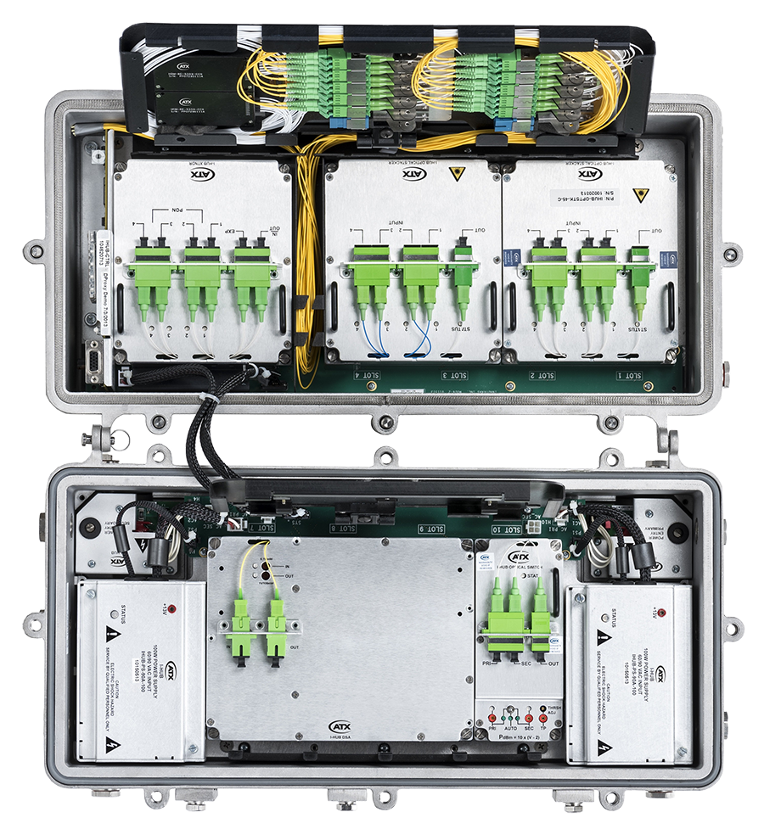
Product Overview – I-HUB
Field-hardened, strand or pedestal mount
10 single or 5 double-width module slots
EDFAs, optical switches, optical stacker modules
Dual load-sharing redundant 60/90 VAC power supplies
Control module for status monitoring & set up
GUI, CLI, SNMP & hand-held display
Dual power & fiber service cable entry ports
Dual fiber management trays

Slide 6


Key Benefits
Cost Savings – Reduces costs and operational complexity by eliminating the need for costly brick and mortar hub sites and street-side pedestals
Reduced Operational Complexity – Enables MSOs to drive fiber deeper into the network to reduce network complexity and improve reliability
Stretches Fiber Plant – Provides field-optical application for extended reach and to increase the utility of existing fiber plant
Fiber Conservation – Reduces capex by eliminating the need for new fiber installations
Increased Reliability – Enables optical switching for redundancy to be conducted in the outside plant, increasing network reliability

Slide 7
Key Application: Fiber Deep: N+6 to N+0
HEADEND
OPTICAL TRANSPORT
OUTSIDE PLANT & PREM
CENTRALIZED FACILITY
RF Distribution
HFC Node
Legacy Tx / RX
400-600 Homes
2-6 Fibers
Up to 40 km
RF Taps
Internet Data
CMTS
Voice
Field-Mounted
Bi-Directional Transport
Network Distributed
HFC Nodes
BC Video
VOD & Other
Analog & QAM
2-6 Fibers
RF Taps
40-60 Homes
Up to 40 WL/fiber
25 to >100 km
Mux / Demux

Slide 8
Key Application: FTTX (RFoG)
HEADEND
OPTICAL TRANSPORT
OUTSIDE PLANT & PREM
Micro Nodes
CENTRALIZED FACILITY
Field-Mounted
Bi-Directional Transport
Network Distributed
Internet Data
CMTS
2-6 Fibers
1:32 split
32 up to 512 Homes
Voice
Up to 40 km
BC Video
VOD & Other
Analog & QAM

Slide 9
Key Application: Business Services
HEADEND
OPTICAL TRANSPORT
OUTSIDE PLANT
Multi-Service
Router / Switch
Field-Mounted Bi-Directional EDFAs Line powered
Cell Backhaul
MDU Termination
CCAP
FTTB
Digital Optical DWDM Interface
Facility or Field Splice Case
5G Small Cell
Digital DWDM Transport to Support Many Service Connections Deep Into the Network

